Slide 1
Math-810: MMAI Adversarial Search and Game Trees
Dr. Soyiba Jawed
[These slides adapted from Dan Klein and Pieter Abbeel]

Slide 2
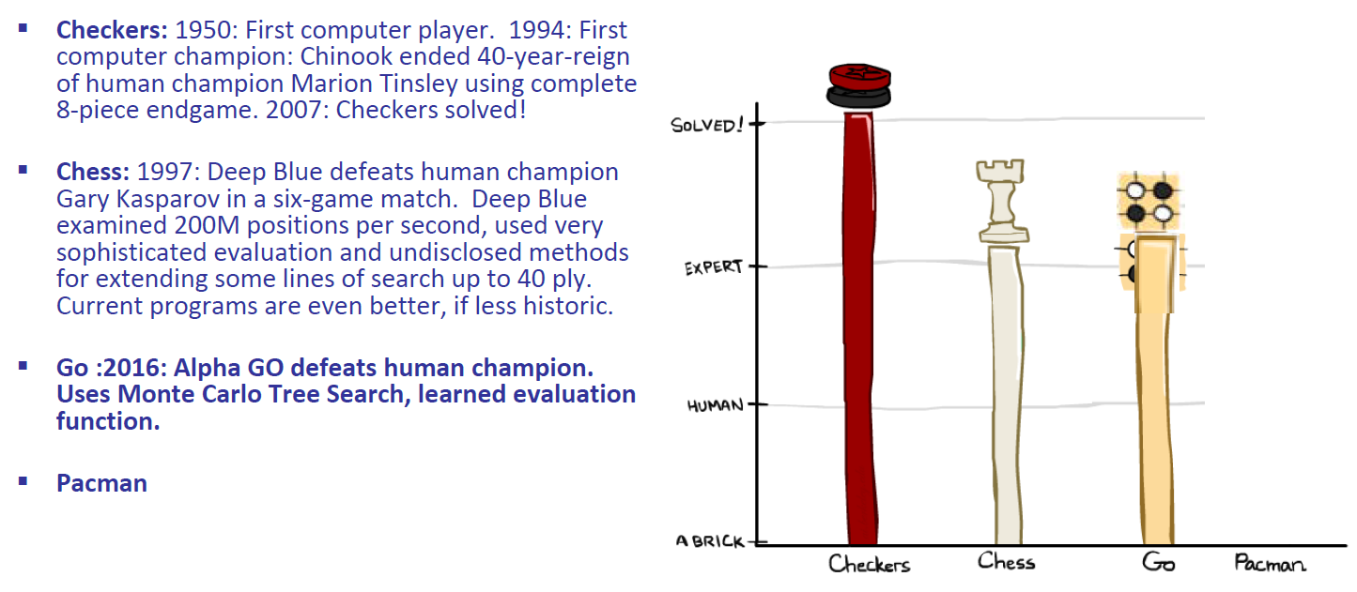
Game Playing state of the art

Slide 3

Agents Getting along with Other Agents

Slide 4

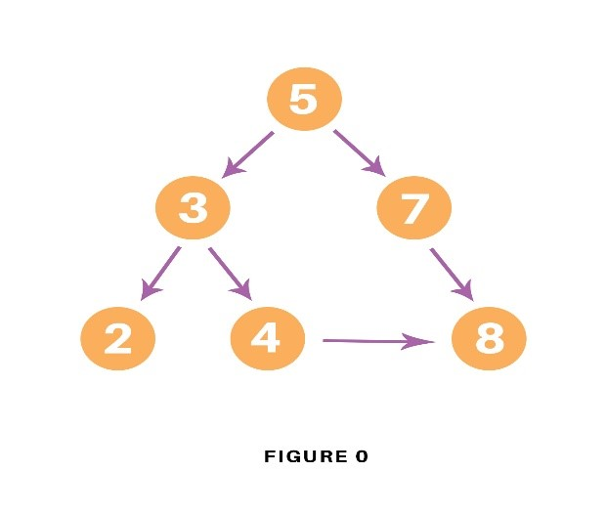
Agents Getting Along with Humans

Slide 5
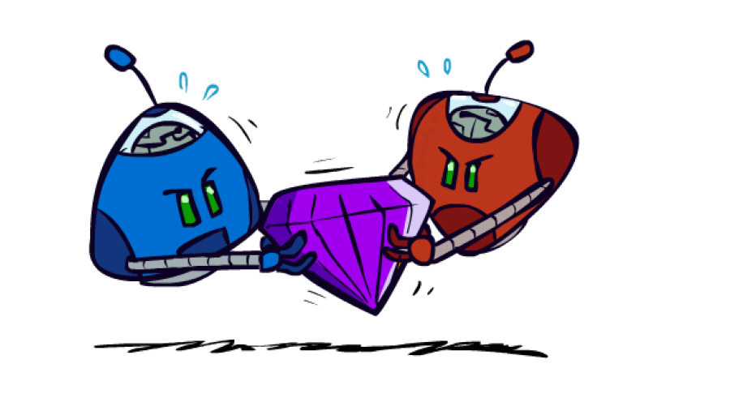
Adversarial Games

Slide 6
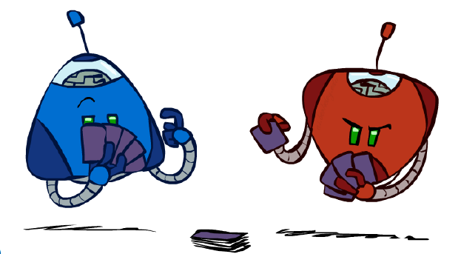
Types of Games
Many different kinds of games !
Axes:
Deterministic or stochastic?
One, two, or more players?
Zero Sum?
Perfect information(can you see the state)?
Want algorithms for calculating a strategy (policy) which recommends a move from each state

Slide 7
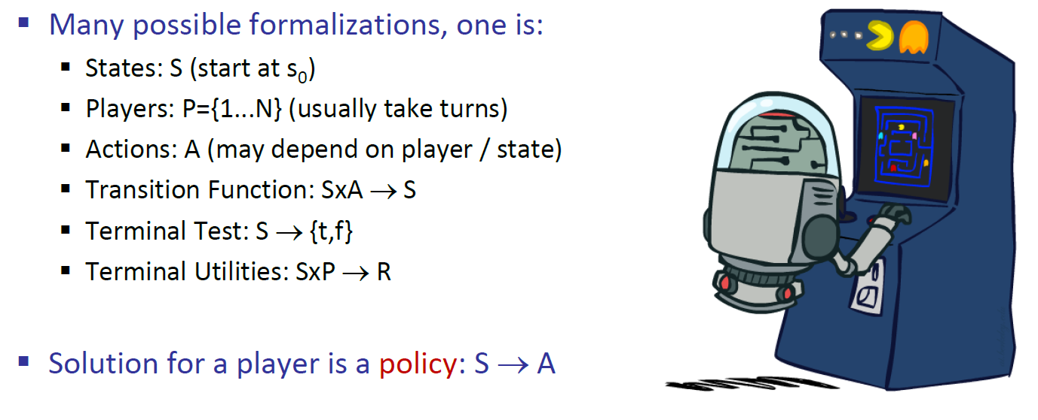
Deterministic Games with Terminal Utilities

Slide 8
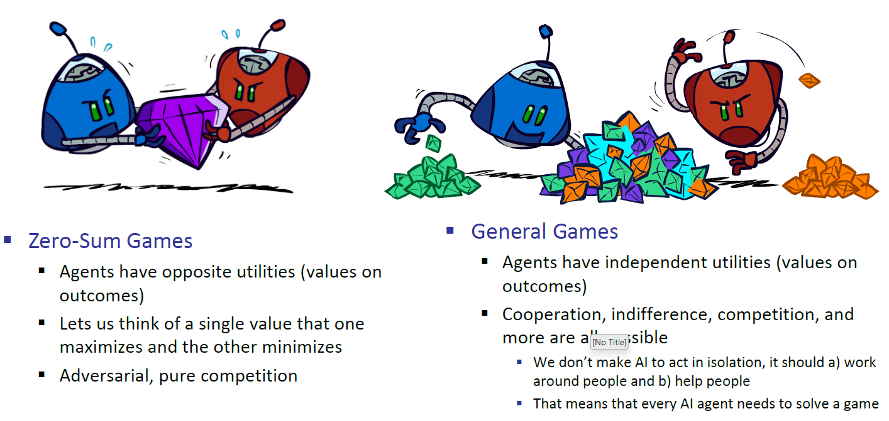
Types of Games

Slide 9
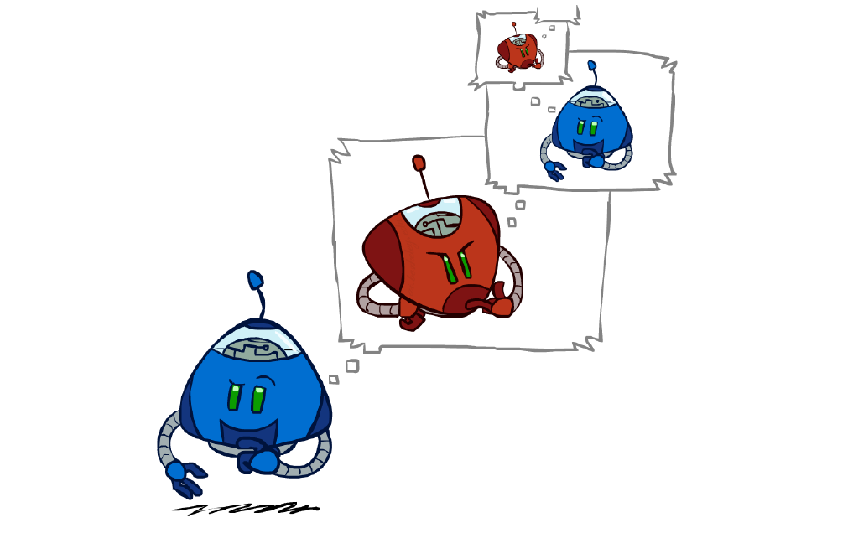
Adversarial Search

Slide 10
News: Cost -> Utility!
No longer minimizing cost!
Agent now wants to maximize its score/utility!

Slide 11
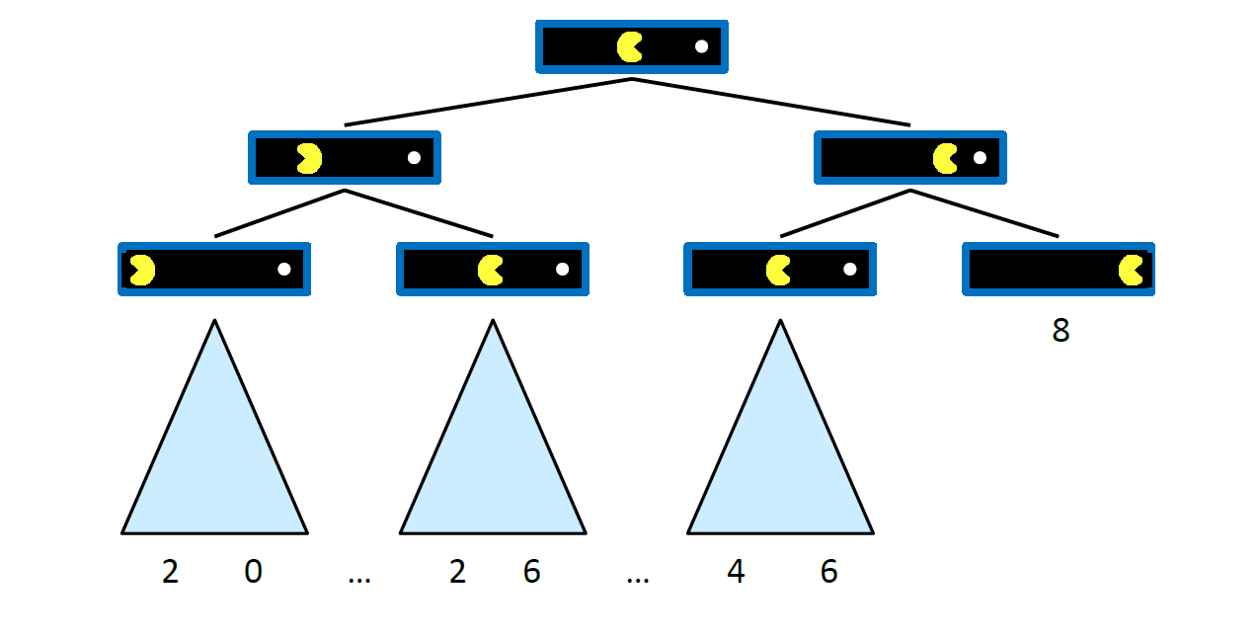
Single Agent Trees

Slide 12
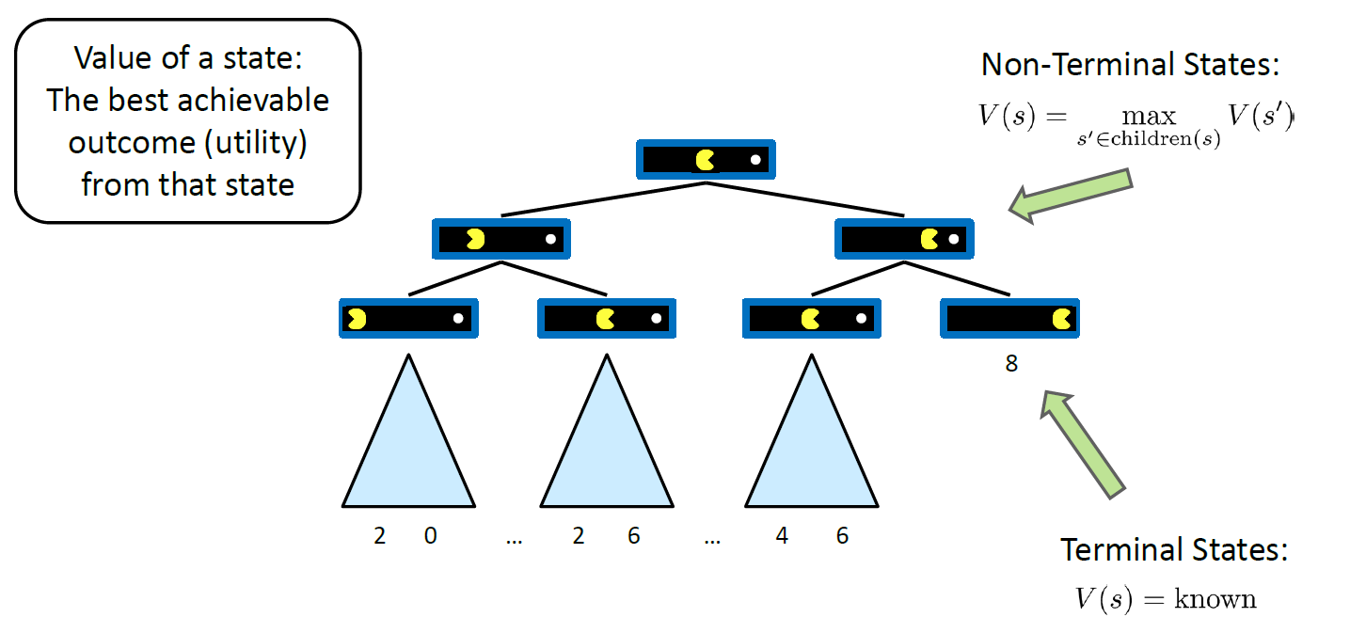
Value of a State

Slide 13
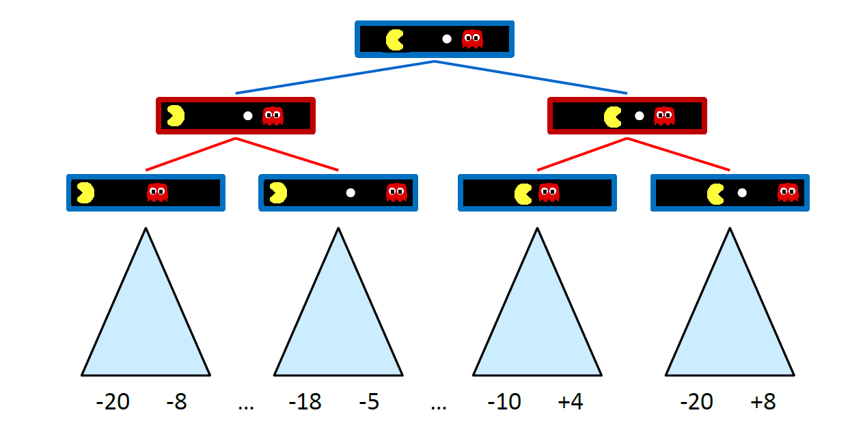
Adversarial Game Trees

Slide 14
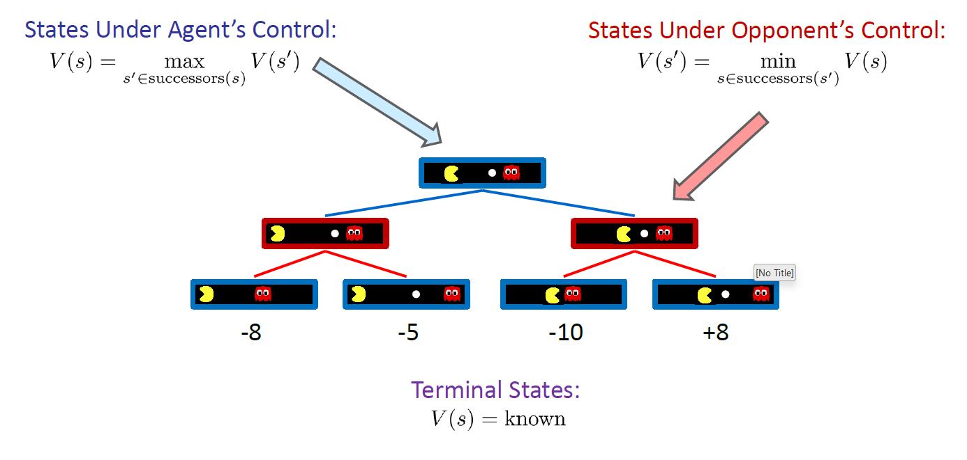
Min Max Values

Slide 15
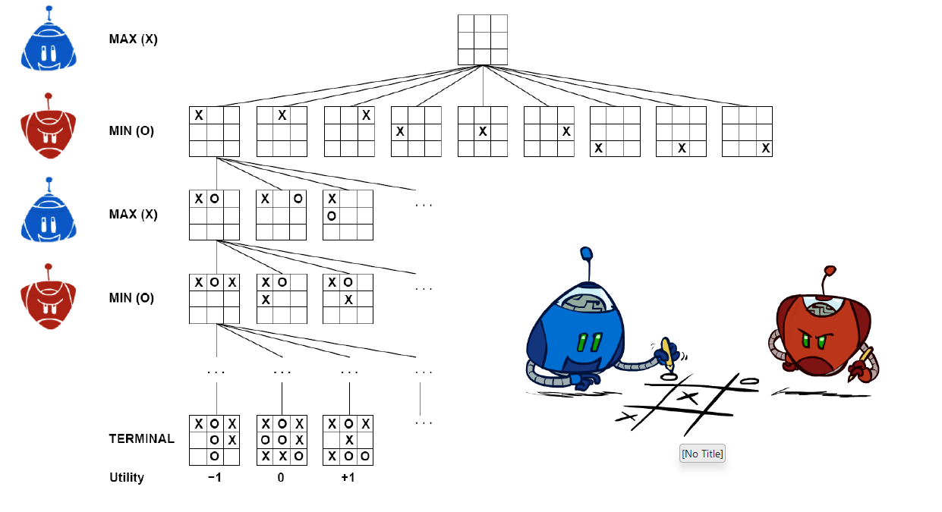
Tic-Tac-Toe Game Tree

Slide 16
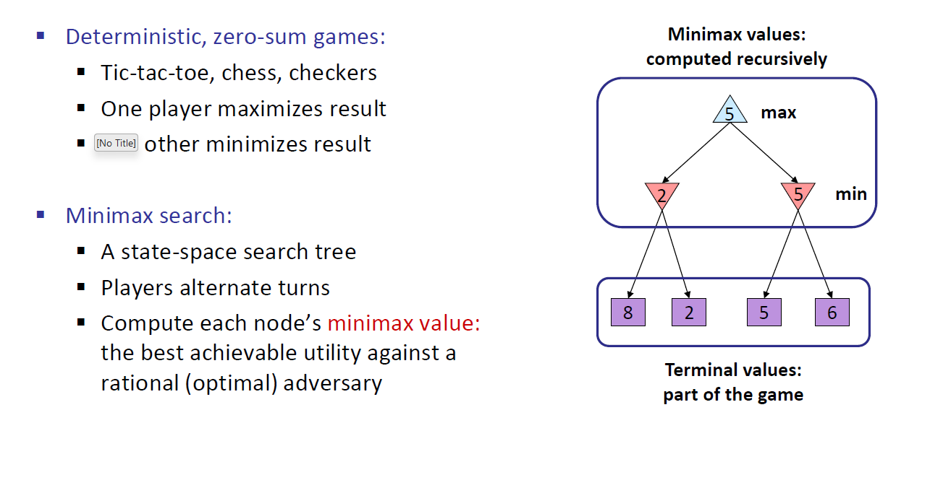
Adversarial Search (Minmax)

Slide 17
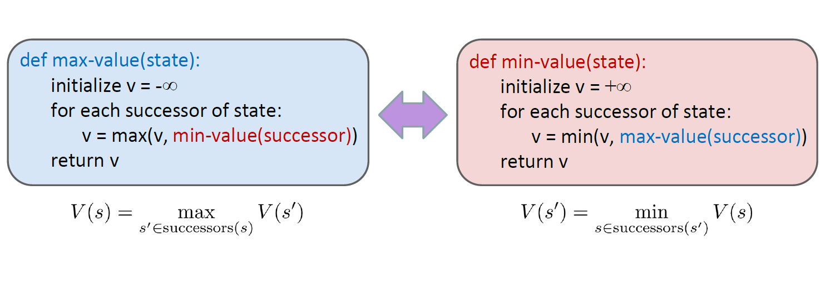
Minimax Implementation

Slide 18
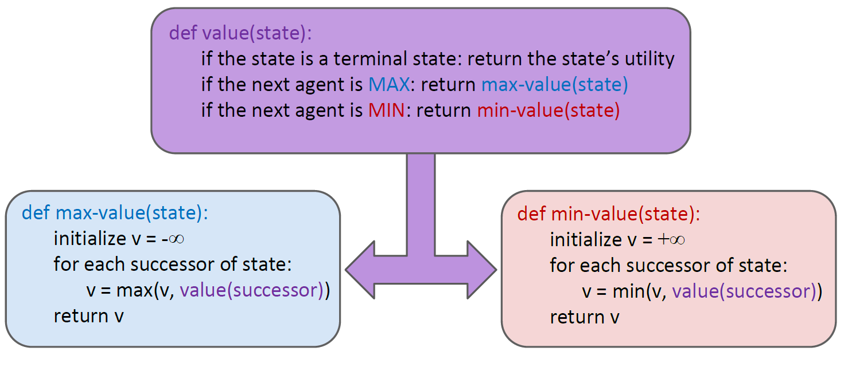
Minimax Implementation (Dispatch)

Slide 19
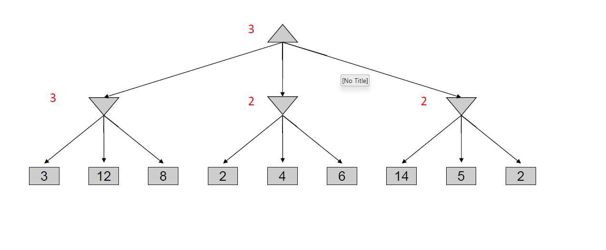
MiniMax Example

Slide 20
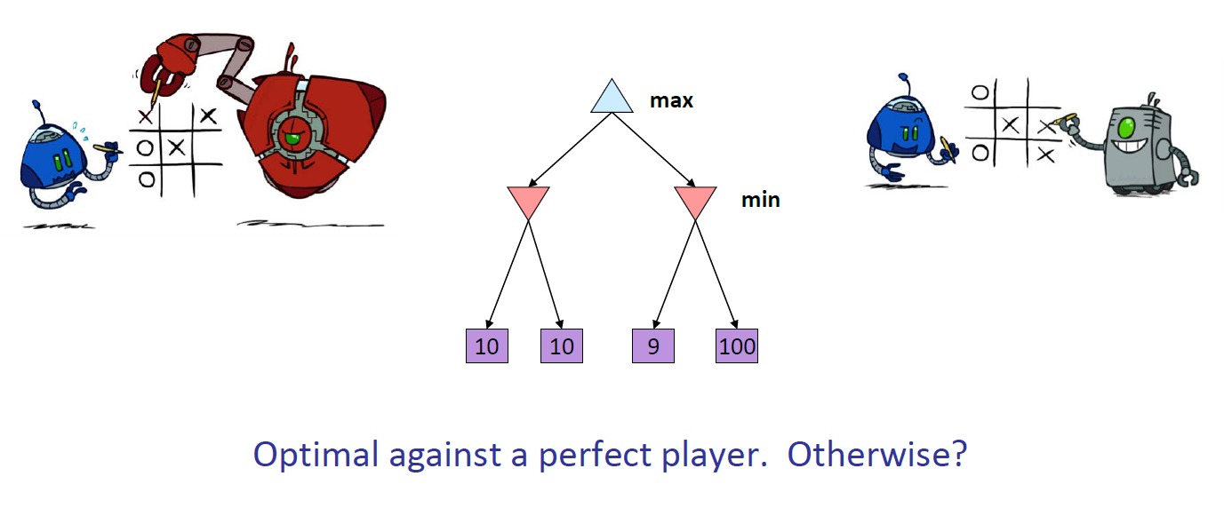
Minimax Properties

Slide 21
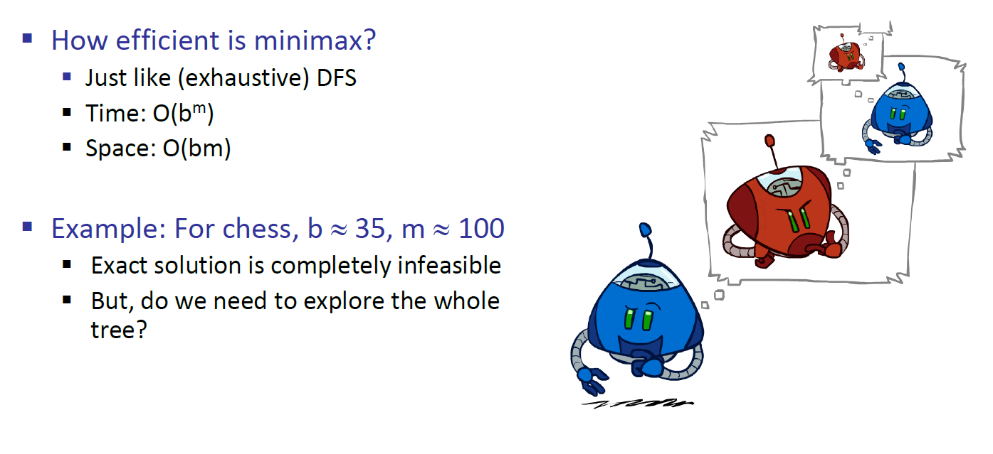
MiniMax Efficiency

Slide 22

Resource limits

Slide 23
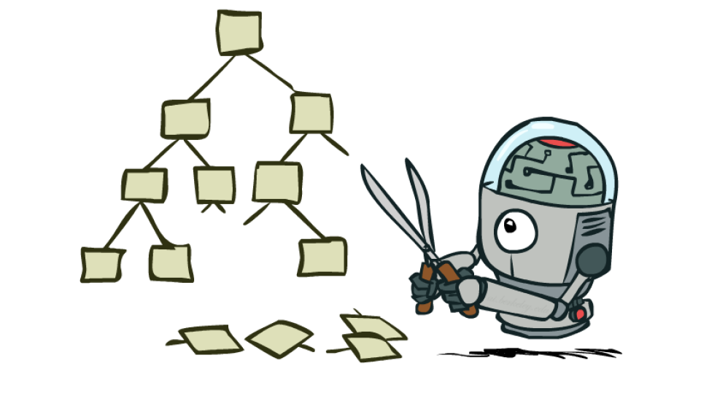
Game Tress Pruning

Slide 24
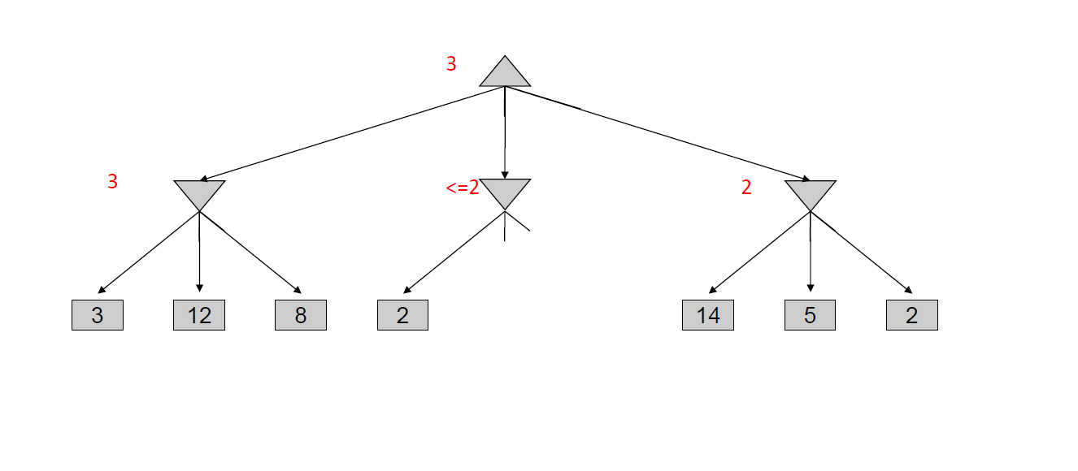
Minimax Example

Slide 25
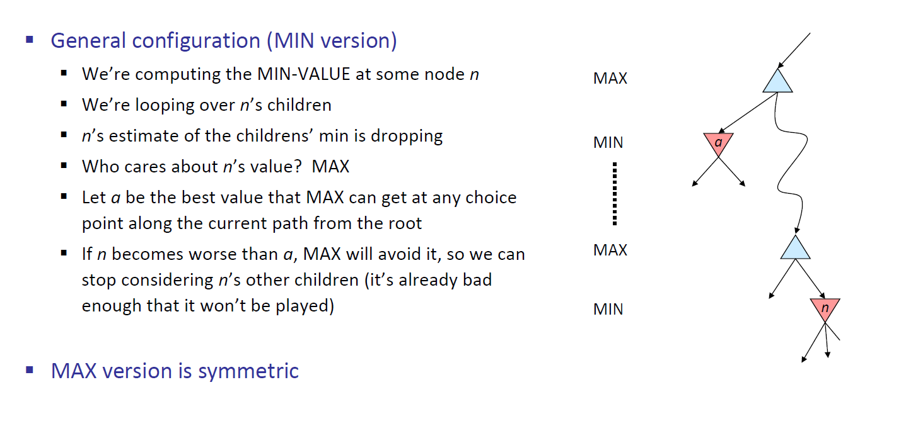
Alpha-Beta Pruning

Slide 26
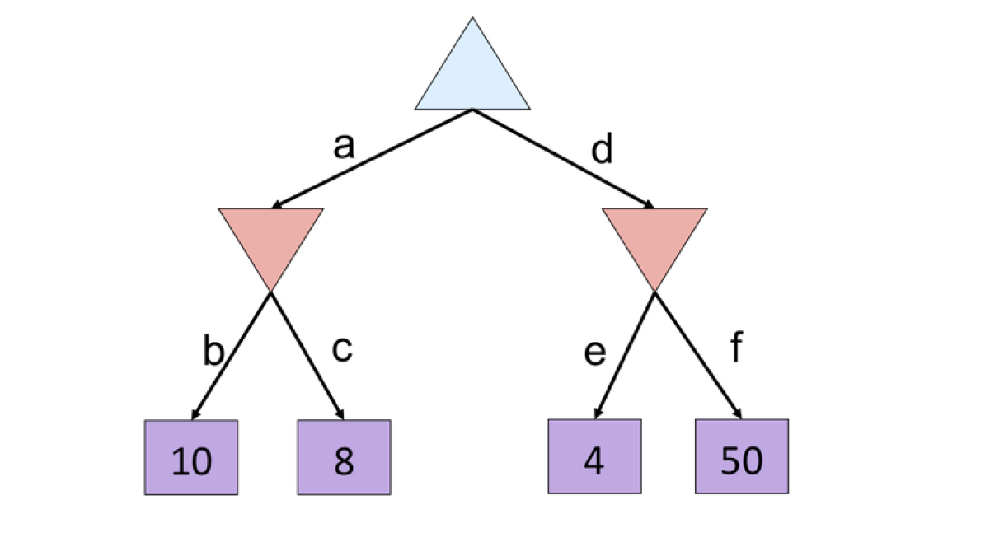
Alpha-Beta example 1

Slide 27
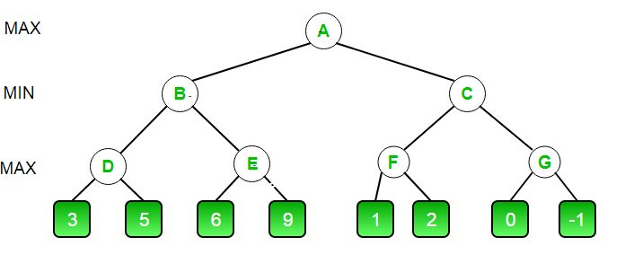
Alpha-Beta example 2

Slide 28
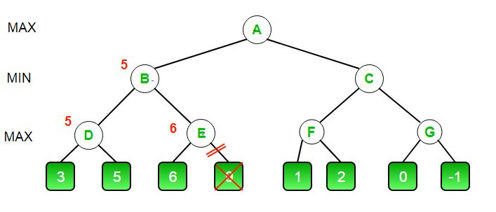
Alpha-Beta example 2

Slide 29
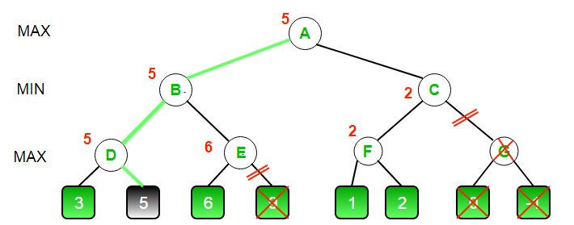
Alpha-Beta example 2

Slide 30
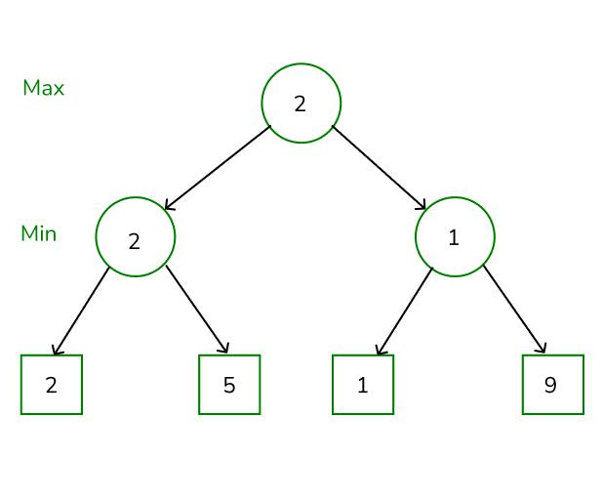
Alpha-Beta example 3

Slide 31
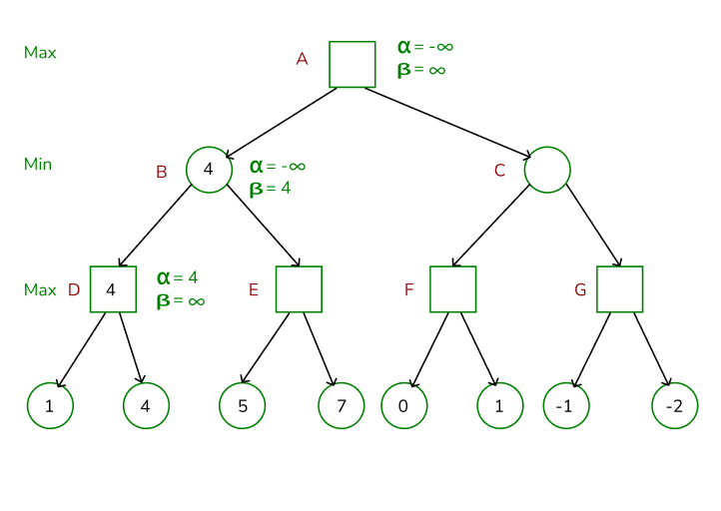
Alpha-Beta example 3

Slide 32
Alpha-Beta example 3

Slide 33
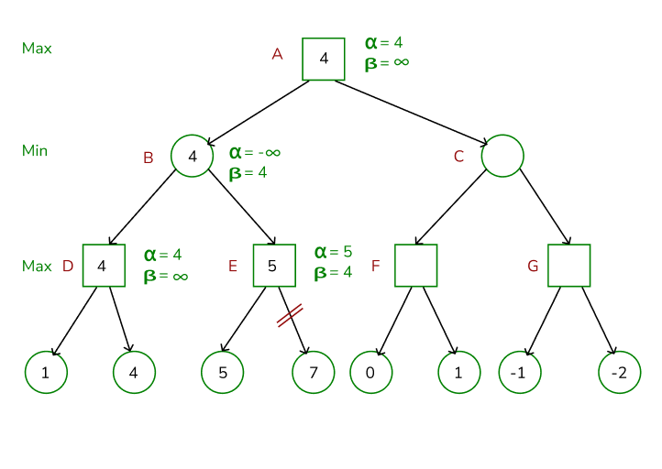
Alpha-Beta example 3

Slide 34
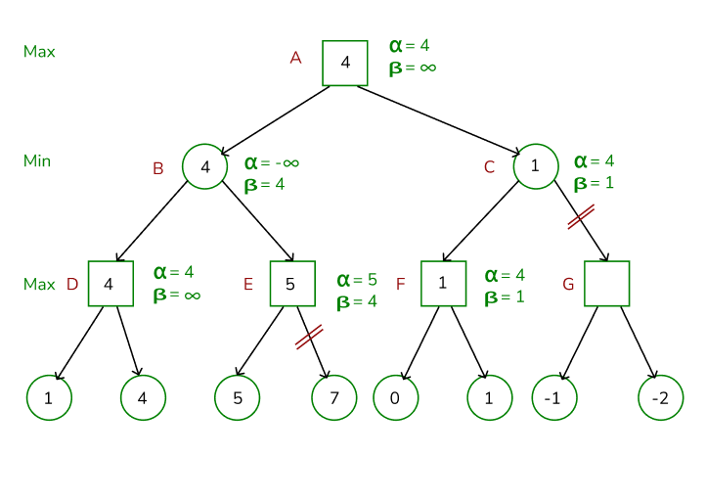
Alpha-Beta example 3

Slide 35
Resource Limits

Slide 36
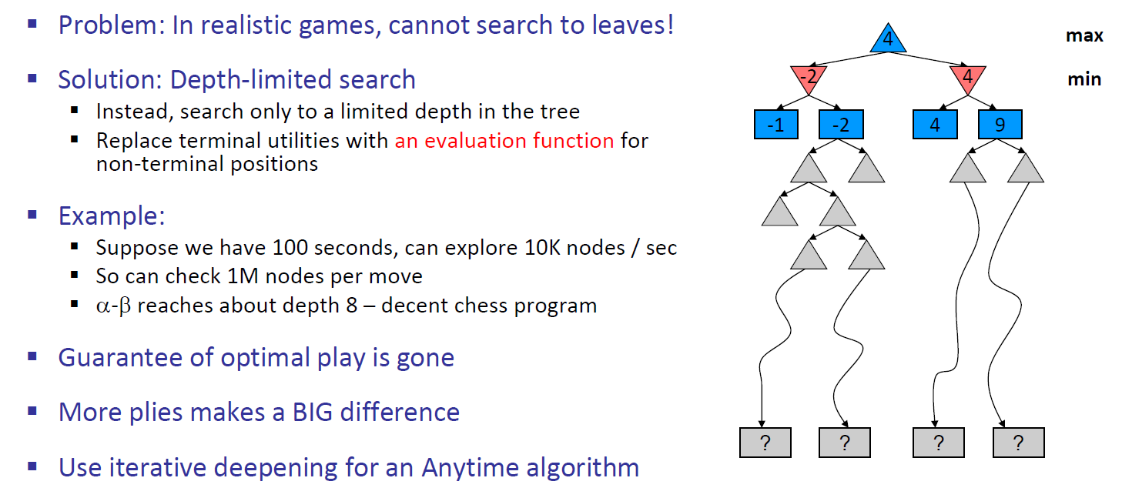
Resource Limits

Slide 37
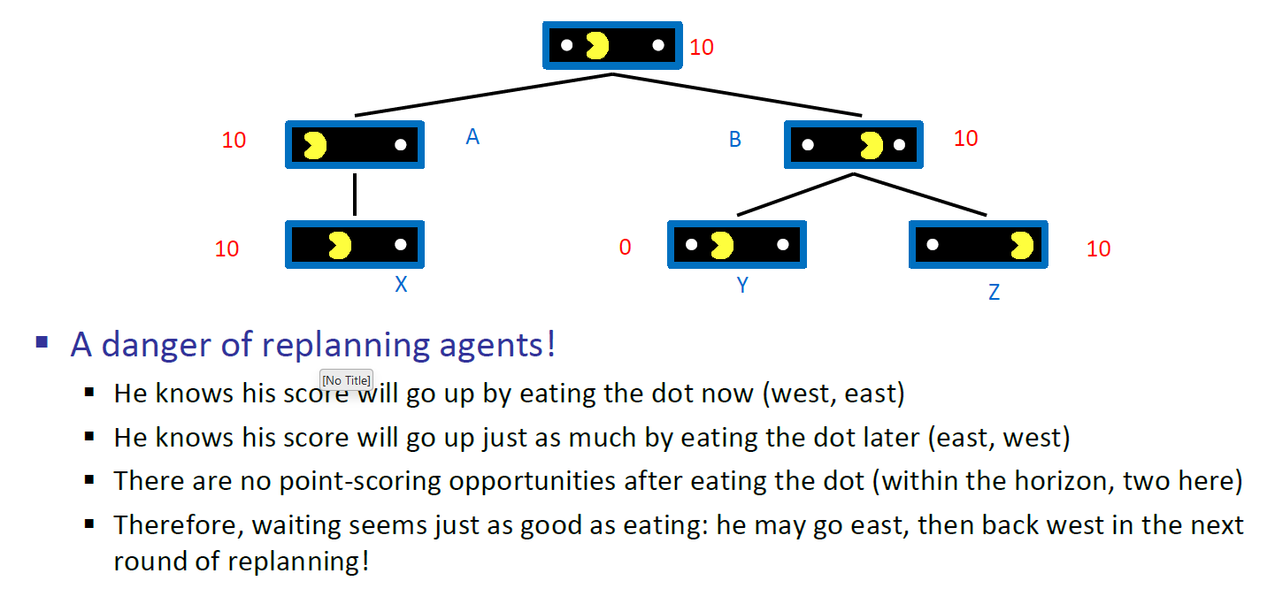
Why Pacman Starves

Slide 38
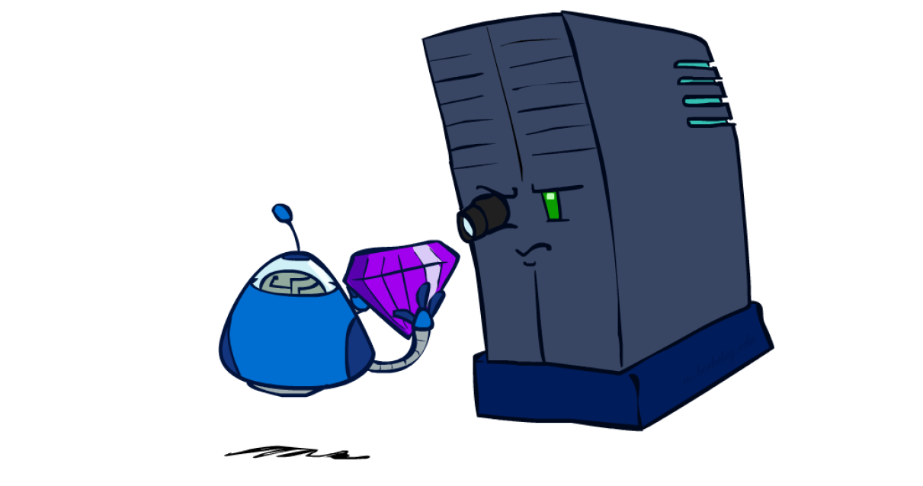
Evaluation Functions

Slide 39
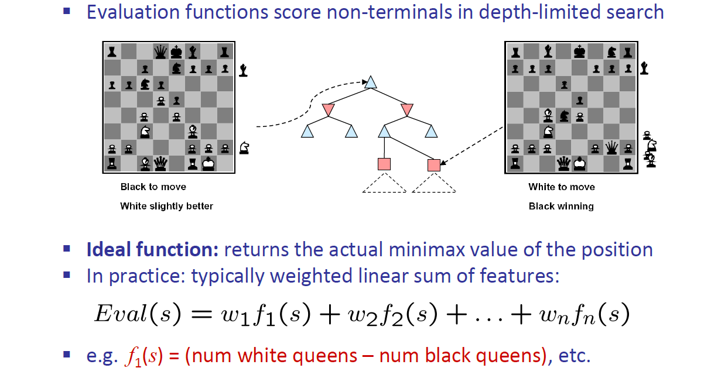
Evaluation Functions

Slide 40
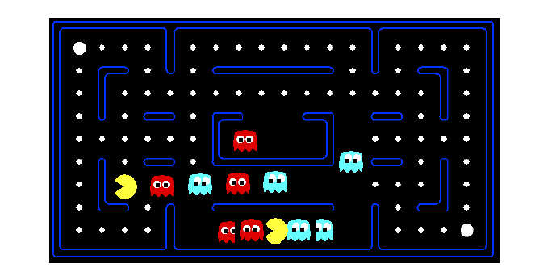
Evaluation For Pacman

Slide 41
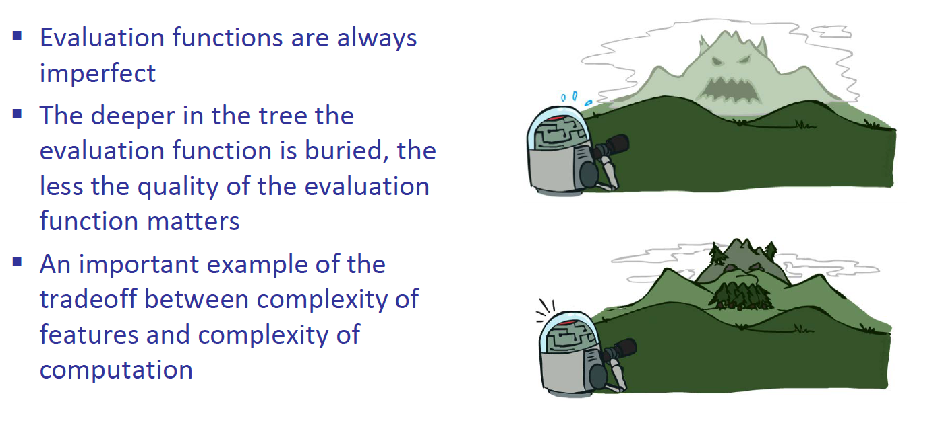
Depth Matters

